Slide 1
Cognitive Science for AI
Vision

Slide 2
Vision
Theory of Color - RGB/CYKZ/HSB, Opponent Process
Edge/Feature Detection - Hubel and Wiesel
Object Recognition, Tracking, Surface Reconstruction
3D representation
Optical Illusions - shows where mechanisms aren’t literal
Special downstream processing
Dorsal Stream - movement, attention, tracking V2,V5/MT,V6/DM
Ventral Stream - V4, form and object recognition
Facial recognition
Fusiform Face Area (FFA): inferior temporal, fusiform gyrus
Buildings and places
Parahippocampal Place Area (PPA): medial temporal lobe
Body and Body parts
Extrastriate Body Area (EBA): lateral occipito-temporal cortex

Slide 3
Optical Illusions
Show how visual mechanisms differ from snapshot
Special downstream processing

Slide 4
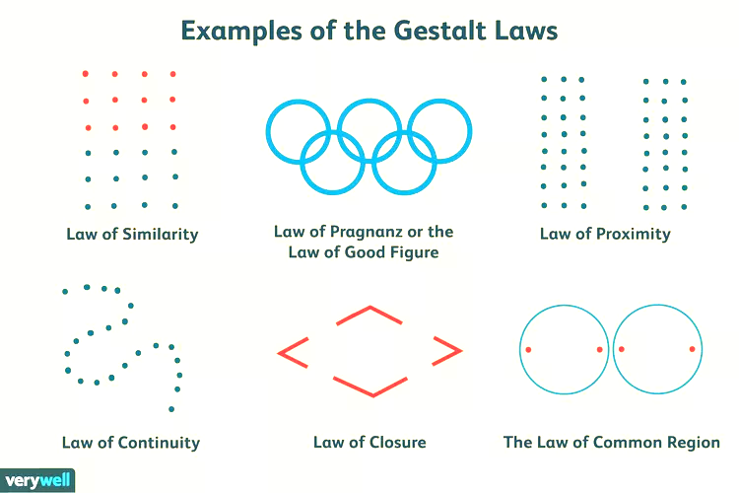


https://www.verywellmind.com/gestalt-laws-of-perceptual-organization-2795835

